Slide 1
BrAPI 101
A Beginners Guide

Slide 2
What is BrAPI?
BrAPI is a …
Standardized
RESTful
Web Service
API
Specification
…for communicating plant breeding data

Slide 3


API – Application Programing Interface
User Interface
GUI
CMD
Hardware
Application Programing Interface
Web Service
Local Messaging Service
Job Queue
Language Library

Slide 4
Web Service
Service Consumer
Request
Response
Sends
2 and 3
Gets
5
A Service Provider contains some Service with well defined Inputs and Outputs
A Service Consumer sends a request to the Service Provider with the Input data, and waits for a response
The Service performs some Function on the Input data
The Service Provider sends the Output data as a Response back to the Service Consumer
Network
Service Provider
Service
X
Function
X + Y = Z
Z
Y
Inputs
Output

Slide 5
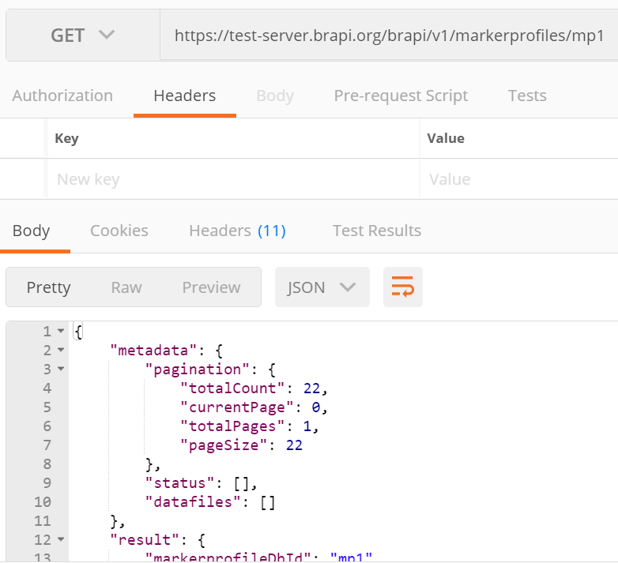
REST - Representational State Transfer
REST is an architecture design for creating Web Services using the well-known HTTP standard
Requests are made with URLs
Data is represented with JSON

Slide 6
Standardized Specification
BrAPI has defined a Standardized set of data model structures to communicate the basic information of plant breeding
BrAPI is a technical Specification which software developers can easily turn into code which communicates using the Standard.

Slide 7
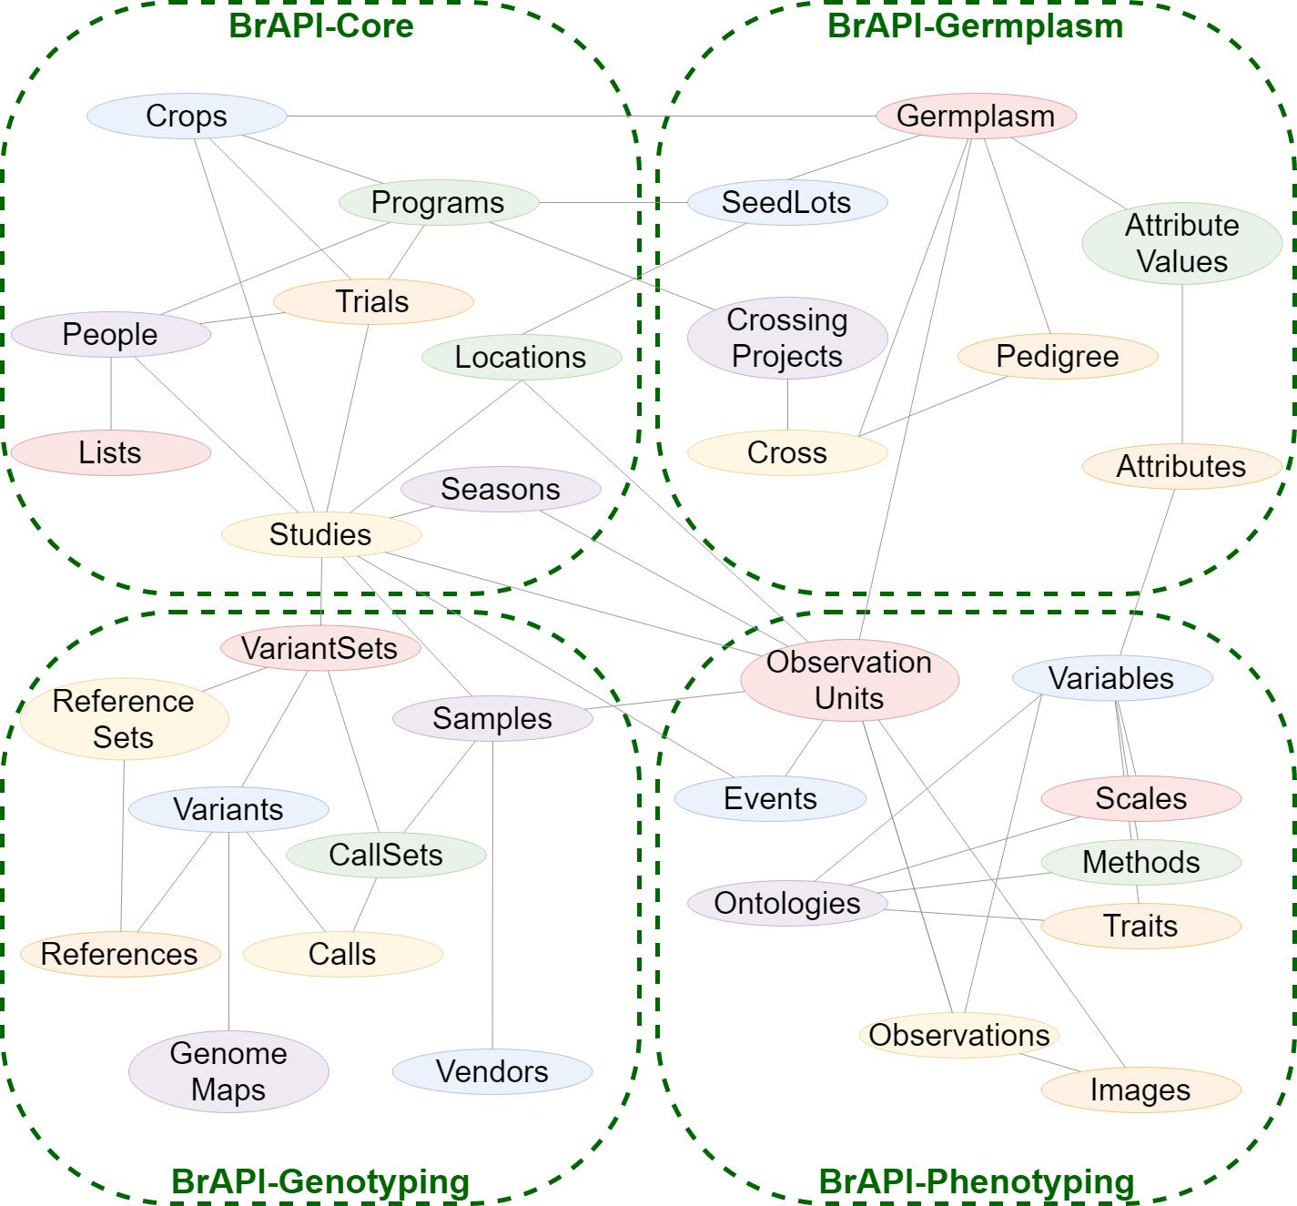
BrAPI Domains
The BrAPI Data Model defines the data and metadata required for any generic breeding trials. The data models are designed to be easily interpreted by a computer in any programing language.

Slide 8
Why do we need BrAPI?

Slide 9
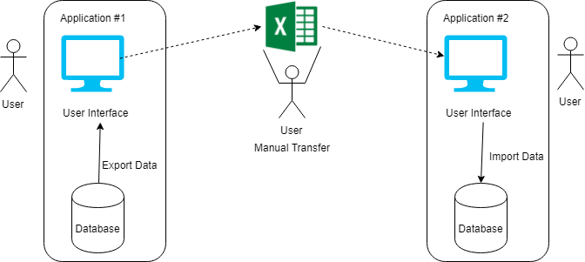
Manual Data Transfer

Slide 10
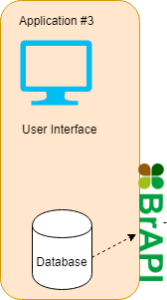
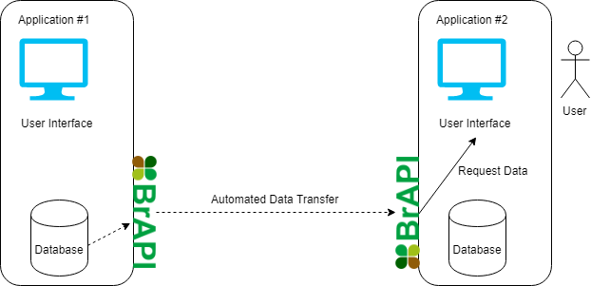
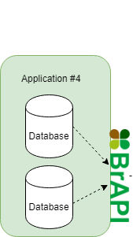
Automated Data Transfer

Slide 11
Who is in the BrAPI Community?

Slide 12
Who is in the BrAPI Community?
37+ registered partner organizations
250+ plant breeders, software developers, data managers, and other expert scientists
6 Elected members of the Advisory Board, managing the long-term goals of the project

Slide 13


Slide 14
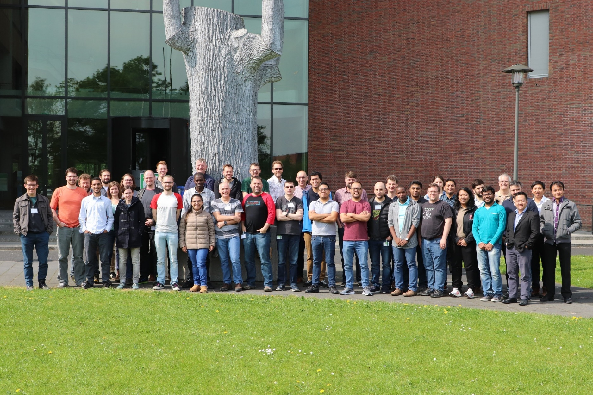





Wageningen, Netherlands - 2019
Hyderabad, India - 2020
Versailles, France - 2018
Texcoco, Mexico - 2018
Dundee, Scotland - 2019
Greenville, SC, USA - 2023
BrAPI Hackathons!!

Slide 15
Applications & Impacts

Slide 16
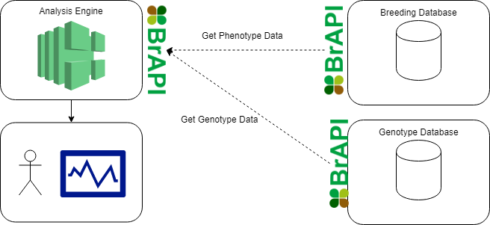
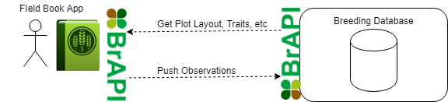
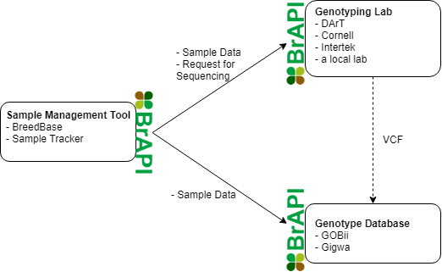
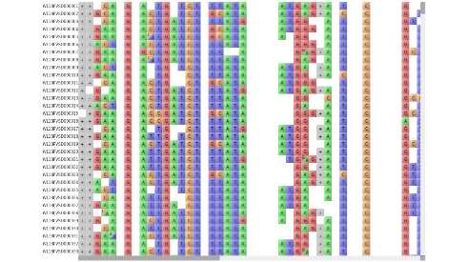
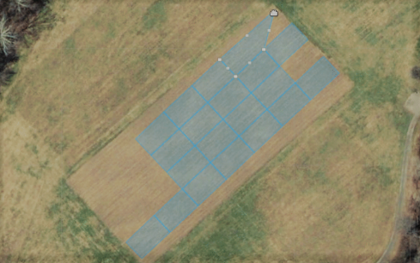
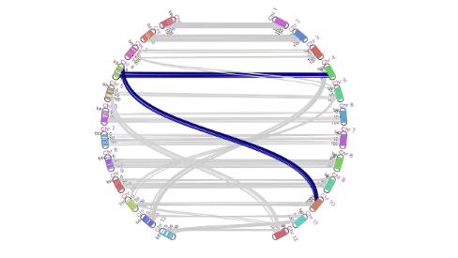
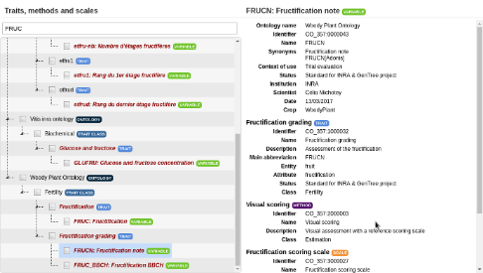
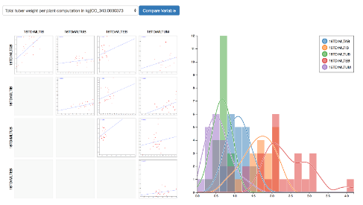
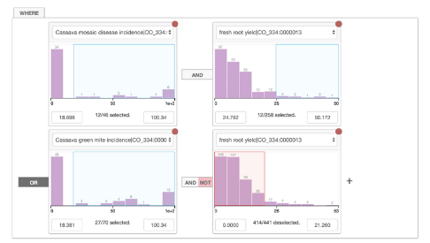
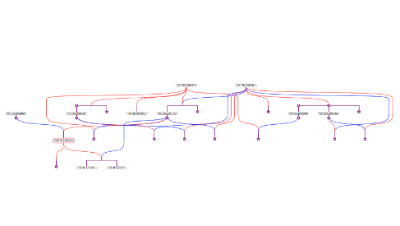
Solved Use Cases
BRAPPs

Slide 17
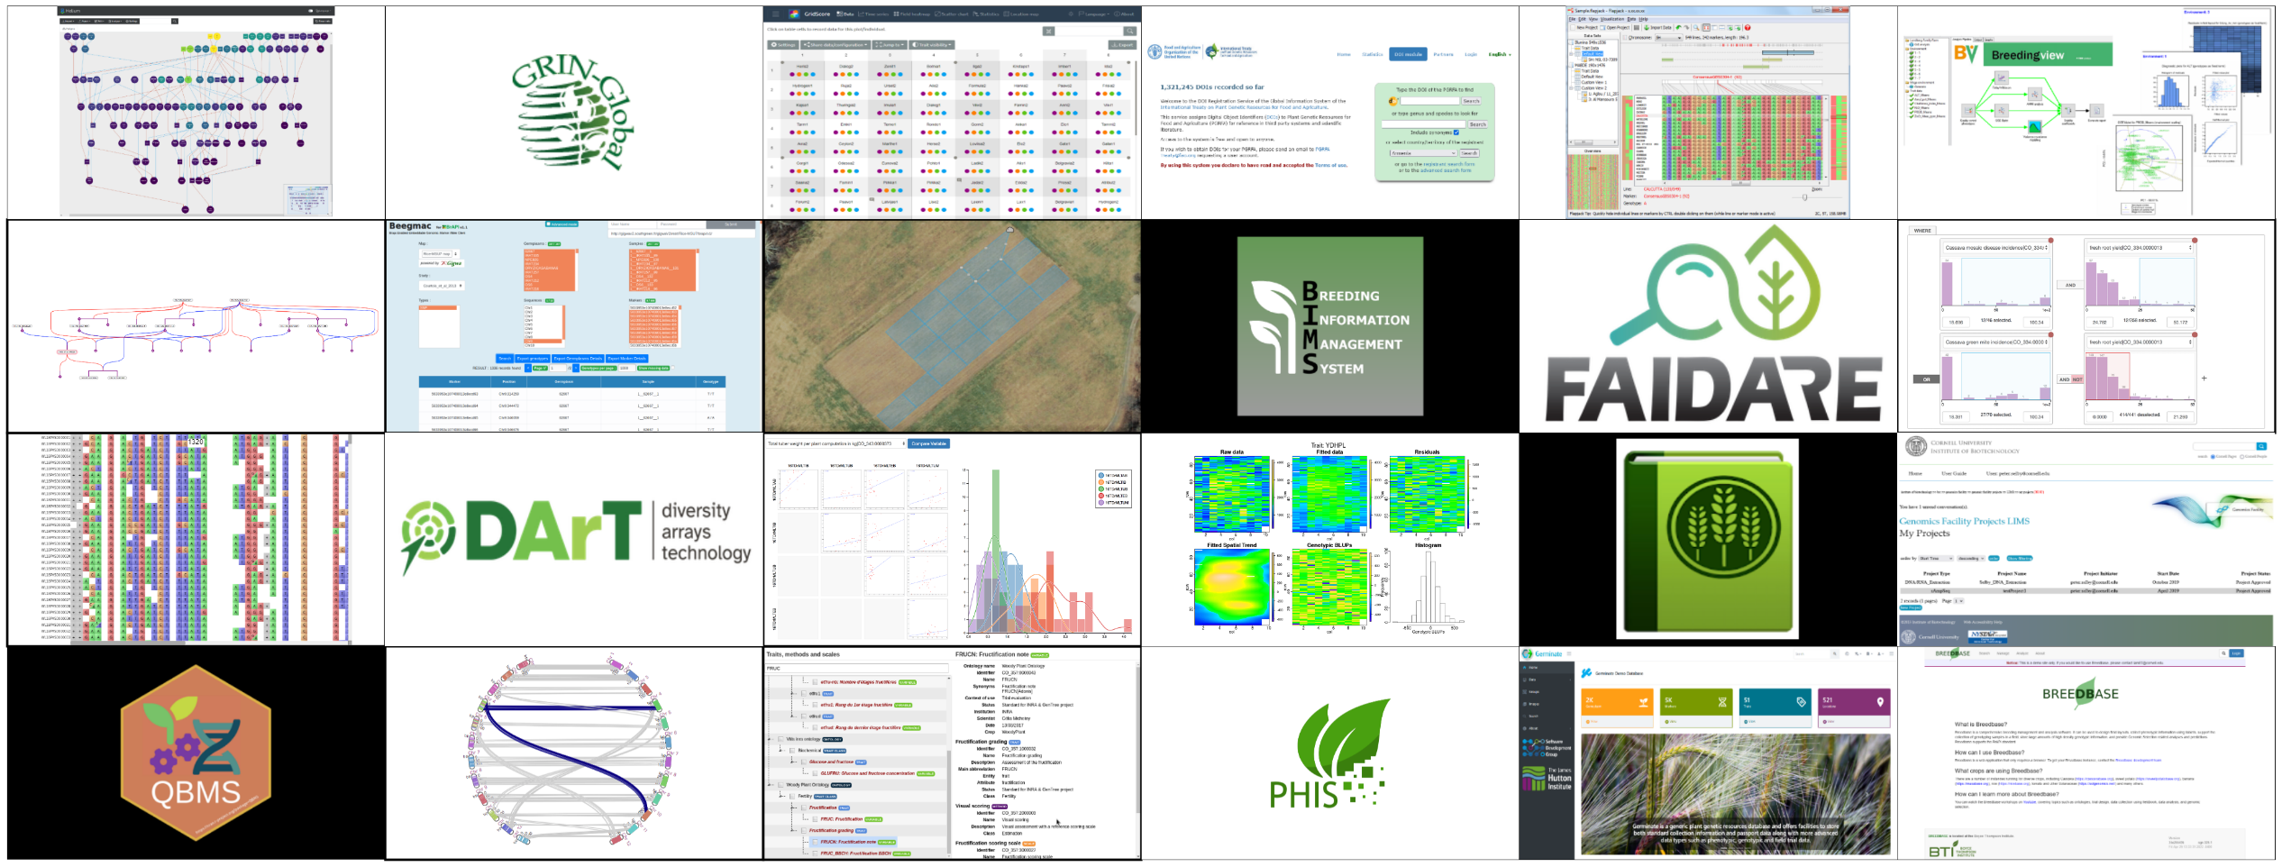
BrAPI Compatible Software

Slide 18
How does BrAPI work?

Slide 19

Typical Request/Response Loop
Client Application
Server Application
UI
Controller
Request Builder
HTTP Service
API Layer
Object Mapping Layer
Database Access Layer
Database
Response Handler
Notes:
In many cases, the most complex part of any BrAPI implementation is mapping proprietary application data to and from the BrAPI standard models. This diagram may look different for different programing languages, libraries, or frameworks, but the general recommendations are the same.
When implementing BrAPI in a client application, it is a good idea to add a request building layer and a response handling layer to the client code stack. The request builder is responsible for translating user actions into standard BrAPI service requests. The response handler is responsible for converting standard BrAPI data models into data structures the UI can interpret.
When implementing BrAPI in a server application, it is a good idea to add an object mapping layer to the server code stack. This layer is responsible for translating between the BrAPI standard models and the internal database models.
By adding these layers, applications can communicate using the standard models without contaminating existing, internal code.

Slide 20
URLs
GET, POST, PUT
https://<specific host path>/brapi/v2/<brapi standard endpoint>
Examples:
GET https://example.org/path/morepath/brapi/v2/studies/3d39af43
GET https://example.org/brapi/v2/studies?germplasmDbId=2d30af45&active=true
POST https://otherexample.org/path/morepath/brapi/v2/studies
PUT https://otherexample.org/brapi/v2/studies/7b3a6f48

Slide 21
Types of BrAPI Endpoints
Retrieve a Single Object by DbId or a Filtered List
GET https://example.org/brapi/v2/studies/3d39af43
GET https://example.org/brapi/v2/studies?germplasmDbId=2d30af45&active=true
Search with Complex Parameters
POST https://example.org/brapi/v2/search/studies {Search Request JSON}
GET https://example.org/brapi/v2/search/studies/5a00af65
Add New Objects
POST https://example.org/brapi/v2/studies {Entity List Request JSON}
Update Existing Object
PUT https://example.org/brapi/v2/studies/7b3a6f48 {Single Entity Request JSON}

Slide 22
Standard Request
Single Entity Request Generally used when updating a single entity using a PUT request
Entity List Request Used when creating multiple entities using a POST request. DbIds are not sent when creating new entities.
Search Request Used when using a complex search endpoint
Single Entity Request
{
“entityName": “Readable Name",
“entityDescription": “Description”,
“listOfDetails": [
"foo", "bar", "baz"
]
...
}
Entity List Request
[
{
“entityName": “Readable Name 1",
“entityDescription": “Desc 1”,
“listOfDetails": [
"foo", "bar", "baz"
]
...
},
{
“entityName": “Readable Name 2",
“entityDescription": “Desc 2”,
“listOfDetails": [
“boo", “far", “faz"
]
...
},
...
]
Search Request
{
“entityDbIds": [
"foo", "bar", "baz"
],
“relatedEntityDbIds": [
"for", "bao", “faz"
],
“dateRangeStart": “2020-01-01”,
“dateRangeEnd": “2020-12-12”,
...
}

Slide 23
Standard Response
Every BrAPI JSON response object has 2 keys
“metadata” key contains information about the call
“result” contains the business data requested by the caller
{
“metadata”: {
“pagination” : {}
...
},
“result”: {
“data”: []
...
}
}

Slide 24
Standard Response - Metadata
“pagination” When the data returned contains a large list, it is often necessary to paginate that list and only retrieve a subset (aka a page). The Pagination object contains meta information about the current paging status, and how many total records and pages are available.
“status” The status key contains an array of Status objects. This allows the server to provide human readable messages which explain what has happened during a particular request.
"metadata": {
"pagination" : {
"totalCount" : 1234,
"pageSize" : 200,
"totalPages" : 7,
"currentPage" : 2
},
"status" : [{
"code" : "Info",
"message" : “Request Received"
}, {
"code" : “Warning",
"message" : “Value ‘xyz’ ignored"
}, {
"code" : “Error",
"message" : “Bad Parameter Value"
},
]
} ...

Slide 25
Standard Response - Result
List Response
"metadata" : {
"pagination" : {
"page" : 1,
"pageSize" : 2,
"totalCount" : 4,
"totalPages" : 2,
...
},
"result" : {
"data" : [
{
“entityDbId": “Unique Identifier 1",
“entityName": “Readable Name 1",
“entityDescription": “Desc 1”,
“listOfDetails": ["foo", "bar", "baz" ]
...
},
{
“entityDbId": “Unique Identifier 2",
“entityName": “Readable Name 2",
“entityDescription": “Desc 2”,
“listOfDetails": [“boo", “far", “faz"]
...
}
]
}
Single Entity Response In this type of response, the "result" key consists of arbitrary properties , and no "data" key (pagination does not apply).
List Response In this type of response, the "result" element only contains the "data" key, which is an arbitrarily long array of objects of the same type. (pagination applies)
Single Entity Response
"metadata" : {
"pagination" : null
...
},
"result" : {
“entityDbId": “Unique Identifier",
“entityName": “Readable Name",
“entityDescription": “Description”,
“listOfDetails": [
"foo", "bar", "baz"
]
...
}

Slide 26
Resources
BrAPI Specification
https://brapi.org/specification
GitHub
https://github.com/plantbreeding/API
ReadTheDocs
https://plant-breeding-api.readthedocs.io/
Compatible Software List
https://brapi.org/compatibleSoftware
Publication
https://doi.org/10.1093/bioinformatics/btz190
Contact
https://brapi.org/contact

